Slide 1
Customer Satisfaction
Quarterly report to improve customer satisfaction and target areas of improvement for Austin-Bergstrom International Airport

Slide 2
Dataset Background
Data Source: Official City of Austin Open Data Portal [data.austintexas.gov]
Data Last Updated: October 5, 2017
Link: https://data.austintexas.gov/City-Government/Airport-Quarterly-Passenger-Survey/dvu8-ztdx
Downloadable data was used instead of json because json file filtered out entries that have zero overall satisfaction

Slide 3
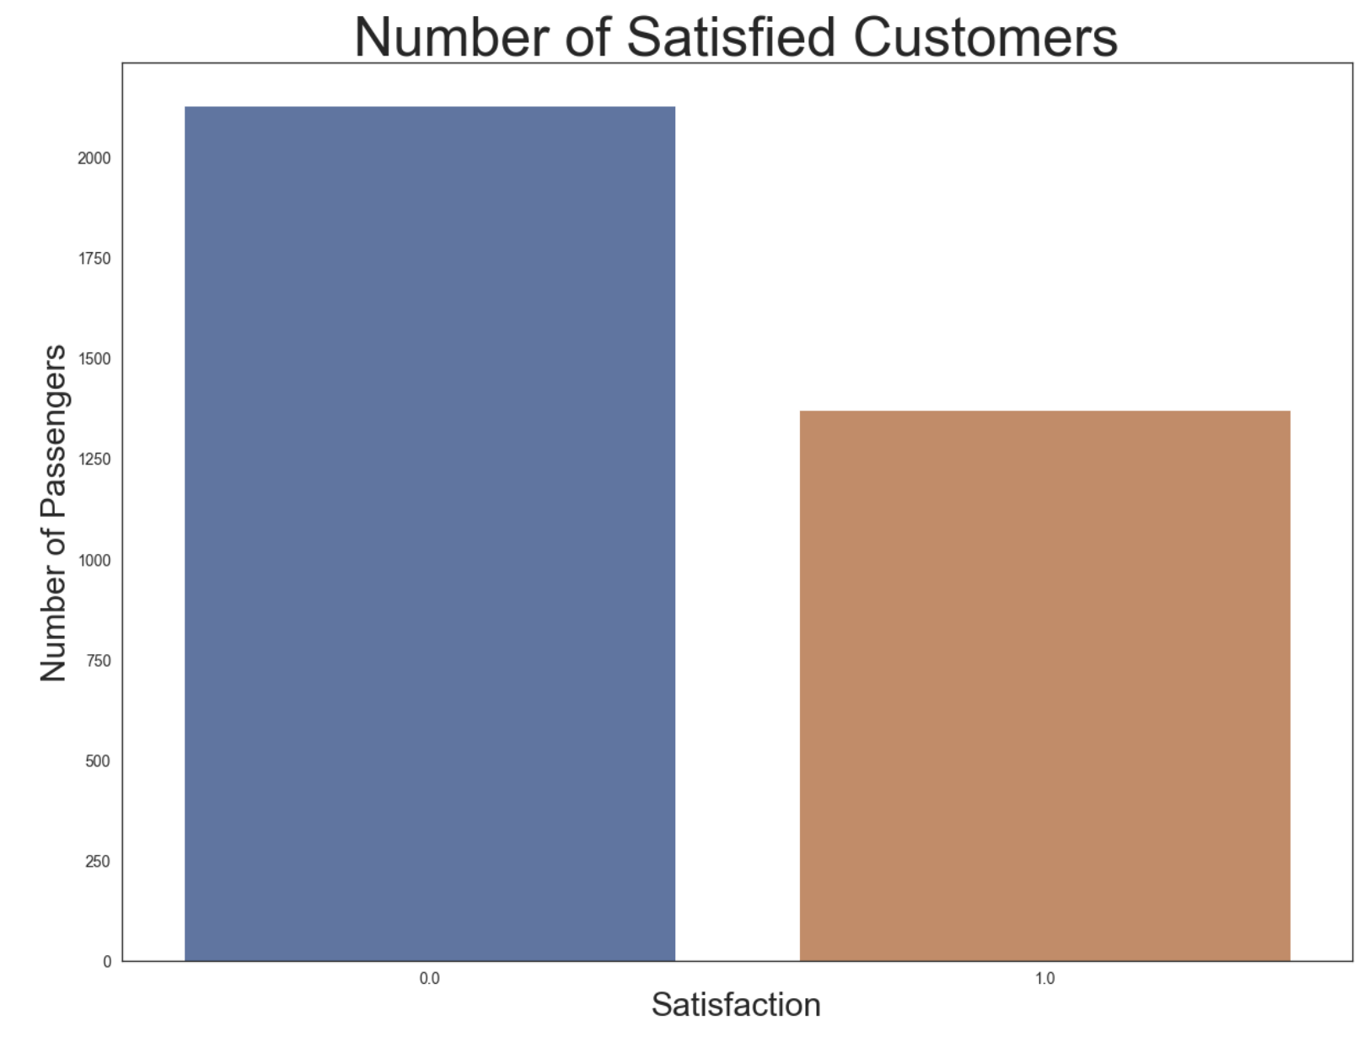
Satisfaction [Overall Satisfaction >=3]

Slide 4
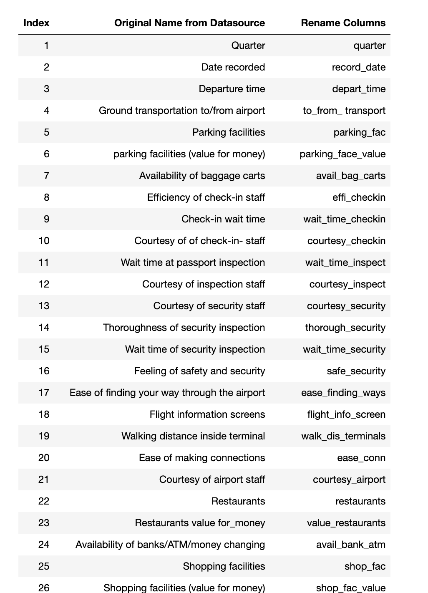
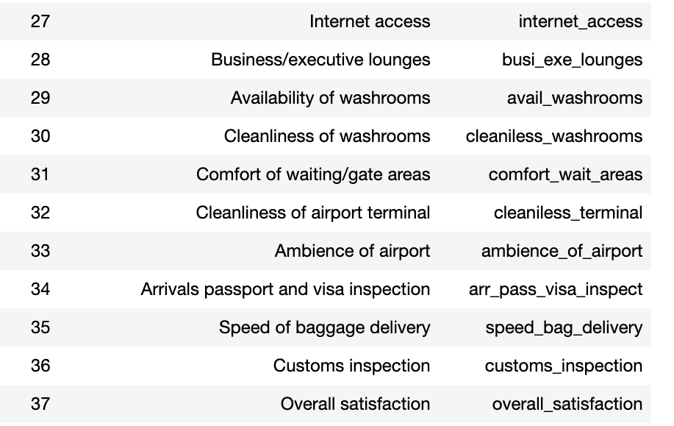
Data Dictionary

Slide 5
Predictor Variable
Method: Forward Feature Selection
Target Variable – Satisfaction
Predictor Variable:
Arrivals passport and Visa Inspection
Speed of Baggage Delivery
Customs Inspection
Comfort of waiting areas/gates

Slide 6
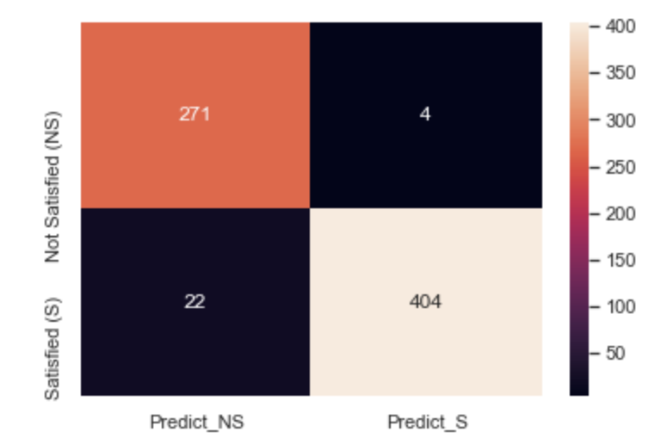
Confusion Matrix

Slide 14
ROC Curve

